Slide 1
Clinic Management System Report
Overview of SQL and Python application for hospital management

Slide 2
Database Schema Overview
Core Tables
Key Features
Department
Primary and foreign keys
Clinic
Referential integrity enforced
Doctor
Many-to-many doctor-appointment link
Patient
Appointment
Doctor_Appointment (junction)

Slide 3
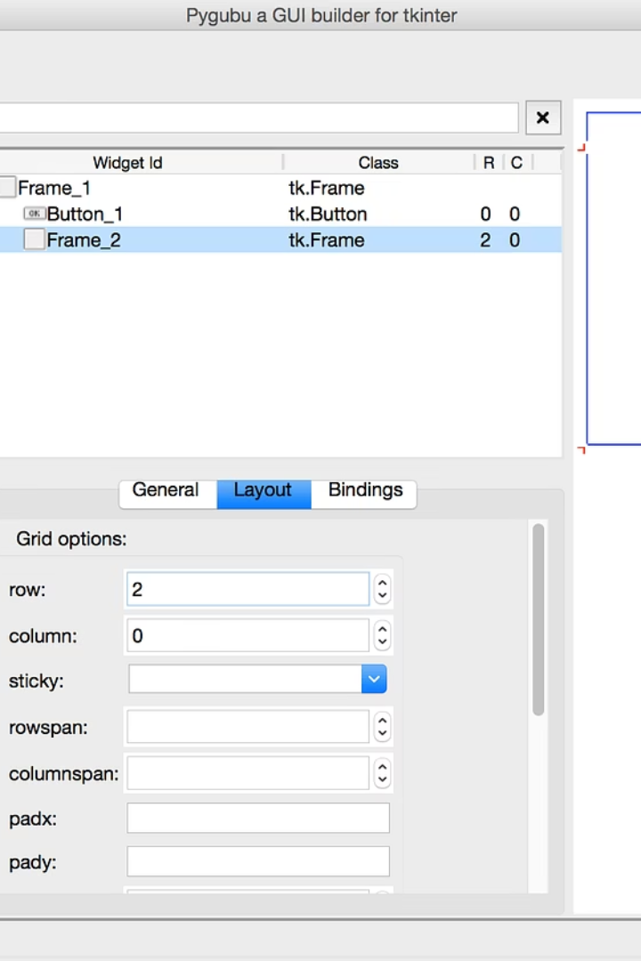
Python Application Features
Add Clinic
View Clinics
Input name, address, select department
Treeview shows clinics with department names
Add Department
Simple interface updates dropdown in real-time

Slide 4

MySQL Database Creation
Database Setup
Table Creation
CREATE DATABASE and USE commands
Department and Clinic tables with constraints
Constraints
NOT NULL and foreign keys for data integrity

Slide 5
Data Insertion Examples
Departments Inserted
Clinics Inserted
Cardiology
Central Clinic
Neurology
Westside Clinic
Skeletal (typo: sketal)
Eastside Clinic
Molecular (typo: molucular)
Digestive (typo: digstive)

Slide 6

SQL Query Examples
Join Clinics and Departments
Retrieve clinics with department names
Filter by Department
Clinics where department is Cardiology

Slide 7

Analysis and Observations
Python GUI
MySQL Schema
User-friendly for clinics and departments
Includes doctors, patients, appointments
SQL Concepts
Table creation
Data insertion
Joins and filtering

Slide 8

Key Recommendations
1
Fix Typos
Correct department names in MySQL code
2
Expand GUI
Add doctors, patients, appointments management
3
Input Validation
Prevent duplicate clinic and department names
4
Error Handling
Check foreign key violations on insertions

Slide 9

Conclusion
Effective use of SQL and Python for clinic management
Robust MySQL schema with constraints
Functional Python GUI for clinics and departments
Potential for full schema implementation

Slide 10
Project Highlights
SQL Skills
Python Application
Schema design
SQLite database
Data insertion
Tkinter GUI
Querying with joins
Real-time updates

